Slide 1
A Quick Intro to R
R Workshop (M/E MBA)
July 20, 2021 Prepared by Jay Cao / TDMDAL
Website: https://tdmdal.github.io/r-workshop-2021-memba/

Slide 2
Goal for Today – Answer Three Questions
What’s R?
What can I use R for?
How to learn R (on my own)?

Slide 3
Plan for Today
Intro to Intro
What is R and what can R do?
Setup R
Motivation examples
How to learn R and a quick walk-through
Basics of R programming
Data science with R
Learning Road Map and Resources

Slide 4


What’s R?
R = a language + an eco-system
A free and open-source programming language
An eco-system of many high-quality user-contributed libraries/packages
In the past R is mostly known for its statistical analysis toolkits
Nowadays R is capable of (and very good at) many other tasks
Tools that cover the whole data analysis workflow
Tools for web technology…

Slide 5
What can R do – Statistics & related
Statistics & Econometrics
Regressions
Time series analysis
Bayesian inference
Survival analysis
…
Numerical Mathematics
Optimization
Solver
Differential equations
…
Finance
Portfolio management
Risk management
Option pricing
…
…
See more R Empirical Finance Packages on R Task View - Finance

Slide 6
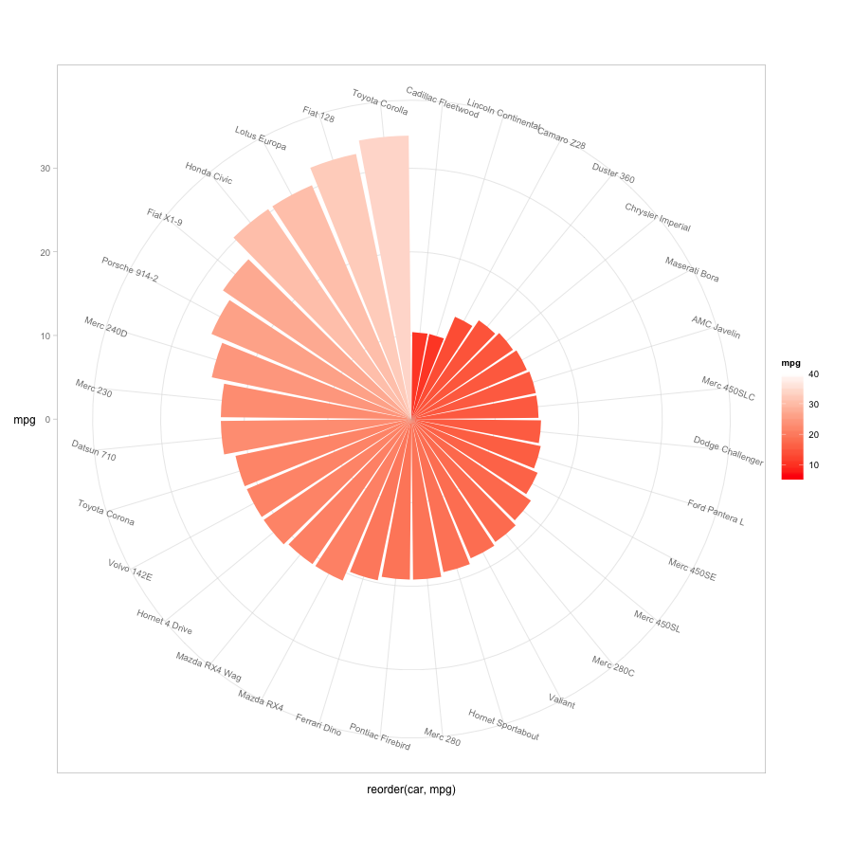
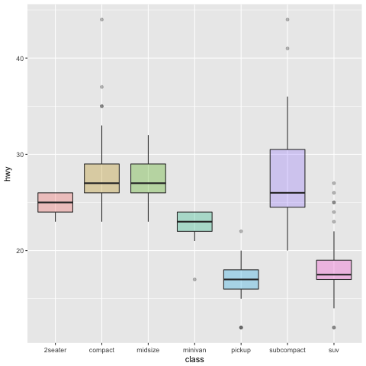
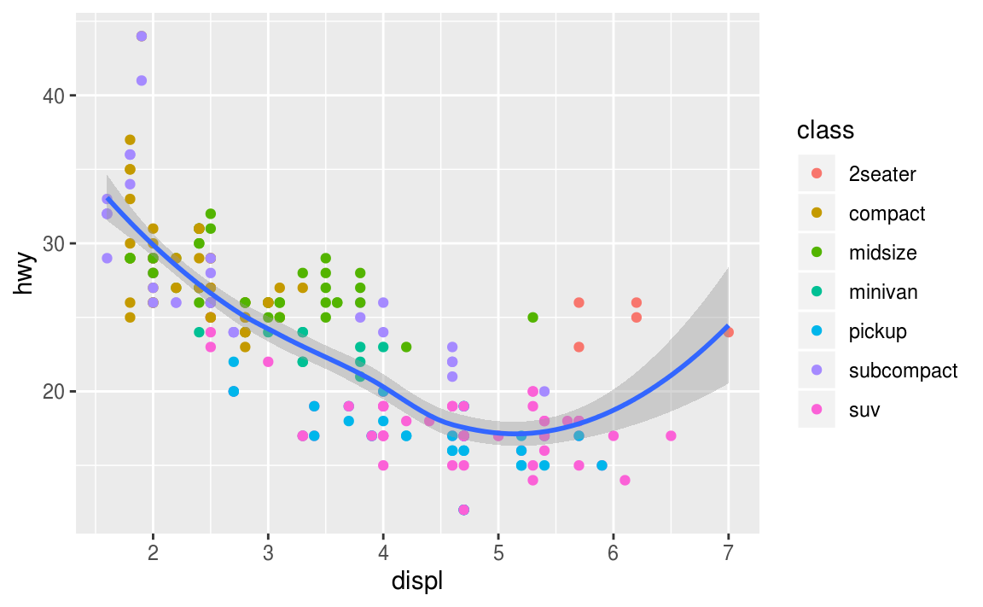
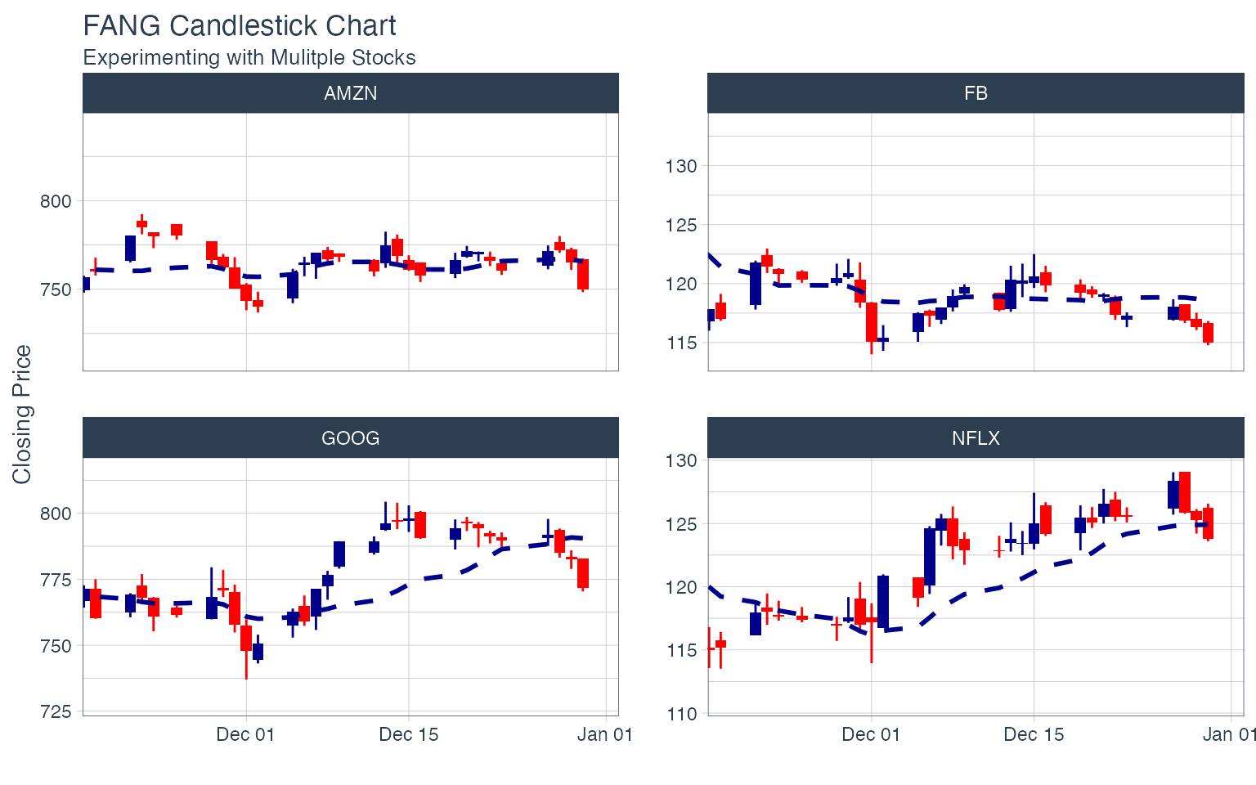
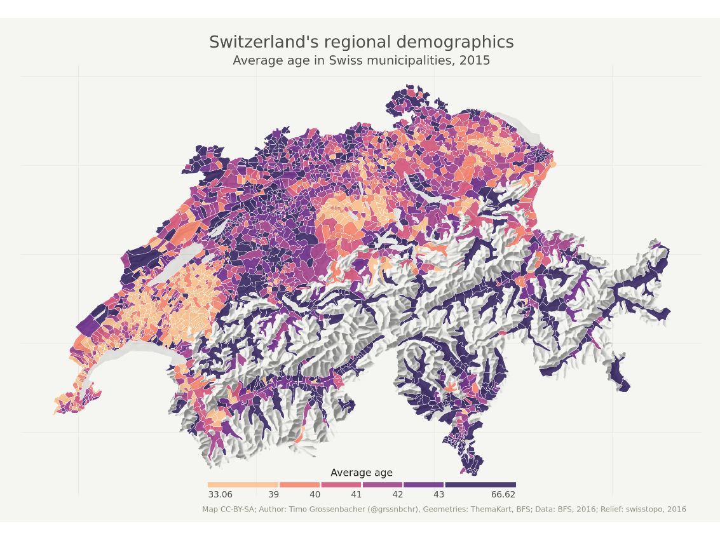
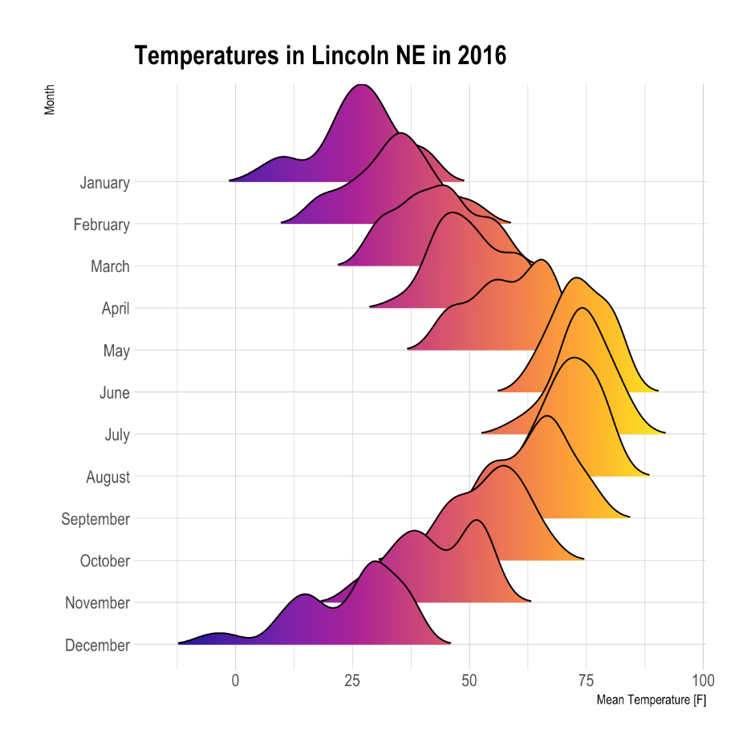
What can R do – Graphics (static ones)
…
https://www.r-graph-gallery.com/
https://timogrossenbacher.ch/2016/12/beautiful-thematic-maps-with-ggplot2-only/;

Slide 7
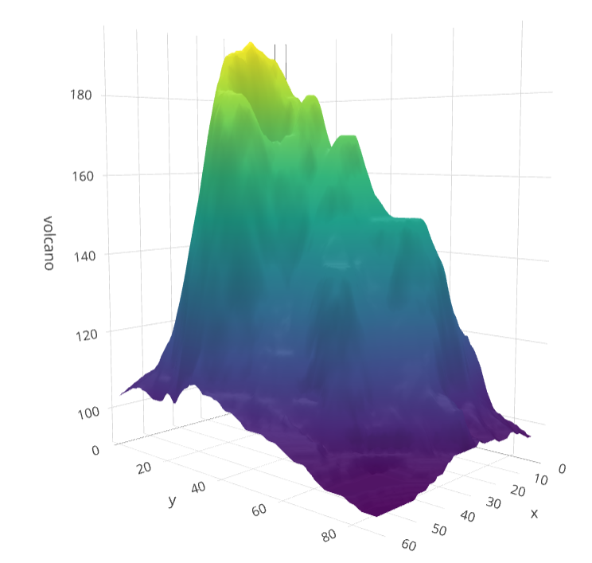
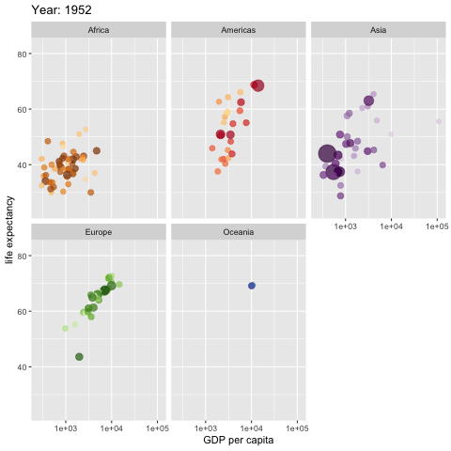
What can R do – Graphics (dynamic ones)
https://plot.ly/r/3d-surface-plots/; https://github.com/thomasp85/gganimate;

Slide 8
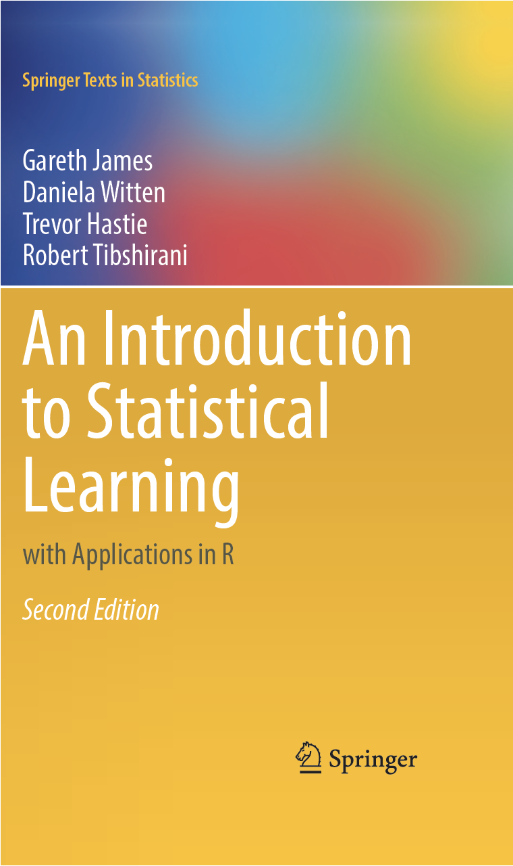




What can R do – Others (1)
Machine learning
Statistical learning (clustering, decision tree, etc.)
An Introduction to Statistical Learning (with Applications in R)
Deep learning (neural networks)
Interface to Keras and Tensorflow (via reticulate, an R to Python interface)
Torch for R (natively from R; similar as PyTorch in Python)
Natural language processing (e.g., tidytext, topicmodels)
1. See more R Machine Learning Packages on R Task View - ML & Statistical Learning
2. See more R Natural Language Processing Packages on R Task View - NLP

Slide 9
What can R do – Others (2)
Web technology
Web scraping (e.g. rvest)
API wrapper (e.g. Twitter: rtweet; bigquery: bigrquery; Quandl: Quandl)
Shiny web app (https://shiny.rstudio.com/)
Reporting
R Markdown (write reports, slides, blogs, books, etc. See a gallery here.)
… (see R Task View for more)

Slide 10




R vs Excel and BI Tools vs Python
Excel & Business Intelligence (BI) Tools (e.g., Tableau, Power BI, etc.)
2-D tables as basic data structure
Good UI (User Interface) and minimum programming
Limited modeling tools
Not easy to reproduce an analysis (because it’s hard to store UI clicks)
Not flexible enough for complicated analysis problems, i.e., problems with
Many data cleaning steps/pipelines
Many different models to try
Python
Very similar to R, but R is more specialized in data analysis
R is much easier to learn (in my opinion)

Slide 11
Why learn R (What can R do for You)?
Beyond Excel Data Analysis
I wish Excel could…
Automate boring repeating tasks
e.g., daily data collection from different sources, weekly dashboard update
Prototype ideas
e.g., a novel trading strategy, a new credit risk model
Really, find anything that interests you and use R…

Slide 12
Plan for Today
Intro to Intro
What is R and what can R do?
Setup R
Motivation examples
How to learn R and a quick walk-through
Basics of R programming
Data science with R
Learning Road Map and Resources

Slide 13
Setup R
R & RStudio on your computer (most of you should choose this one)
Install R (https://www.r-project.org/)
Install RStudio (https://rstudio.com/products/rstudio/download/)
R & RStudio in the Cloud (run R without installation)
RStudio Cloud (https://rstudio.cloud/)
UofT JupyterHub RStudio (https://jupyter.utoronto.ca/hub/login)
R & Notebook in the Cloud (run R without installation)
UofT JupyterHub Notebook (https://jupyter.utoronto.ca/hub/login)
Google Colab (https://colab.to/r)

Slide 14

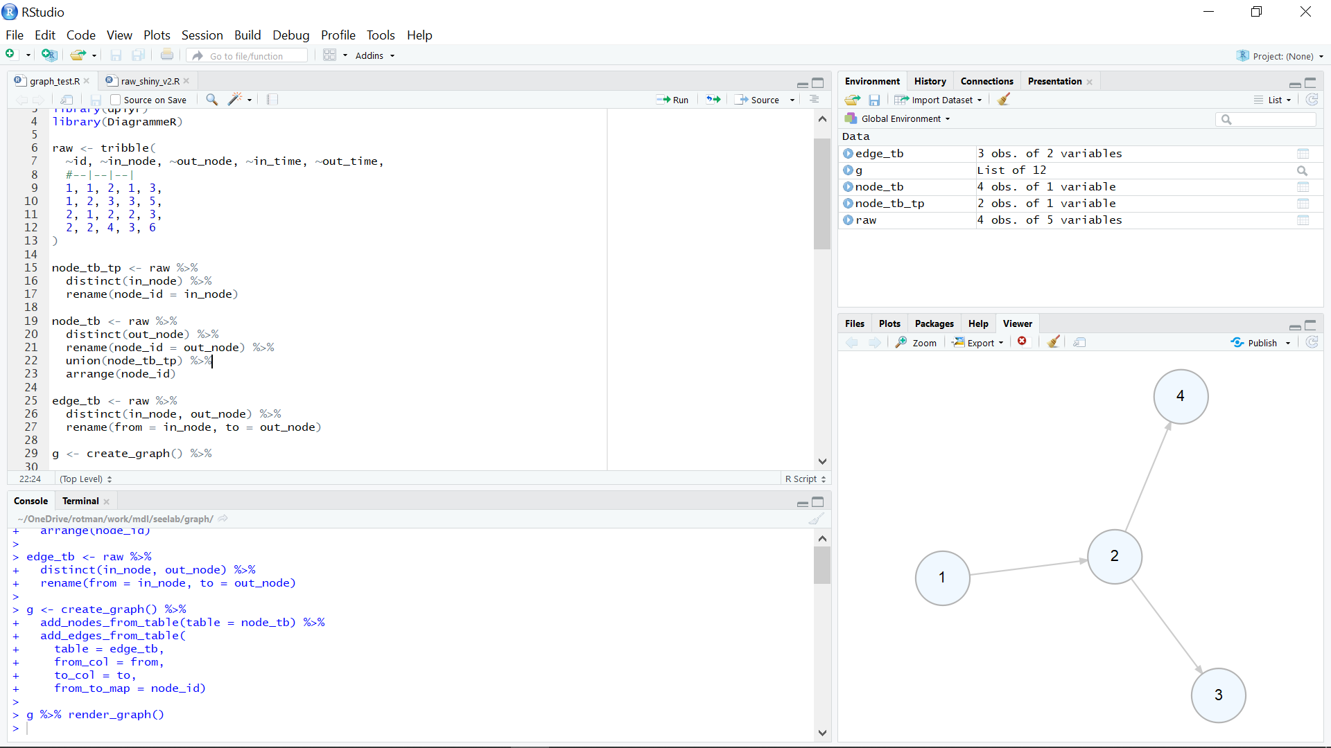
What’s RStudio?

Slide 15
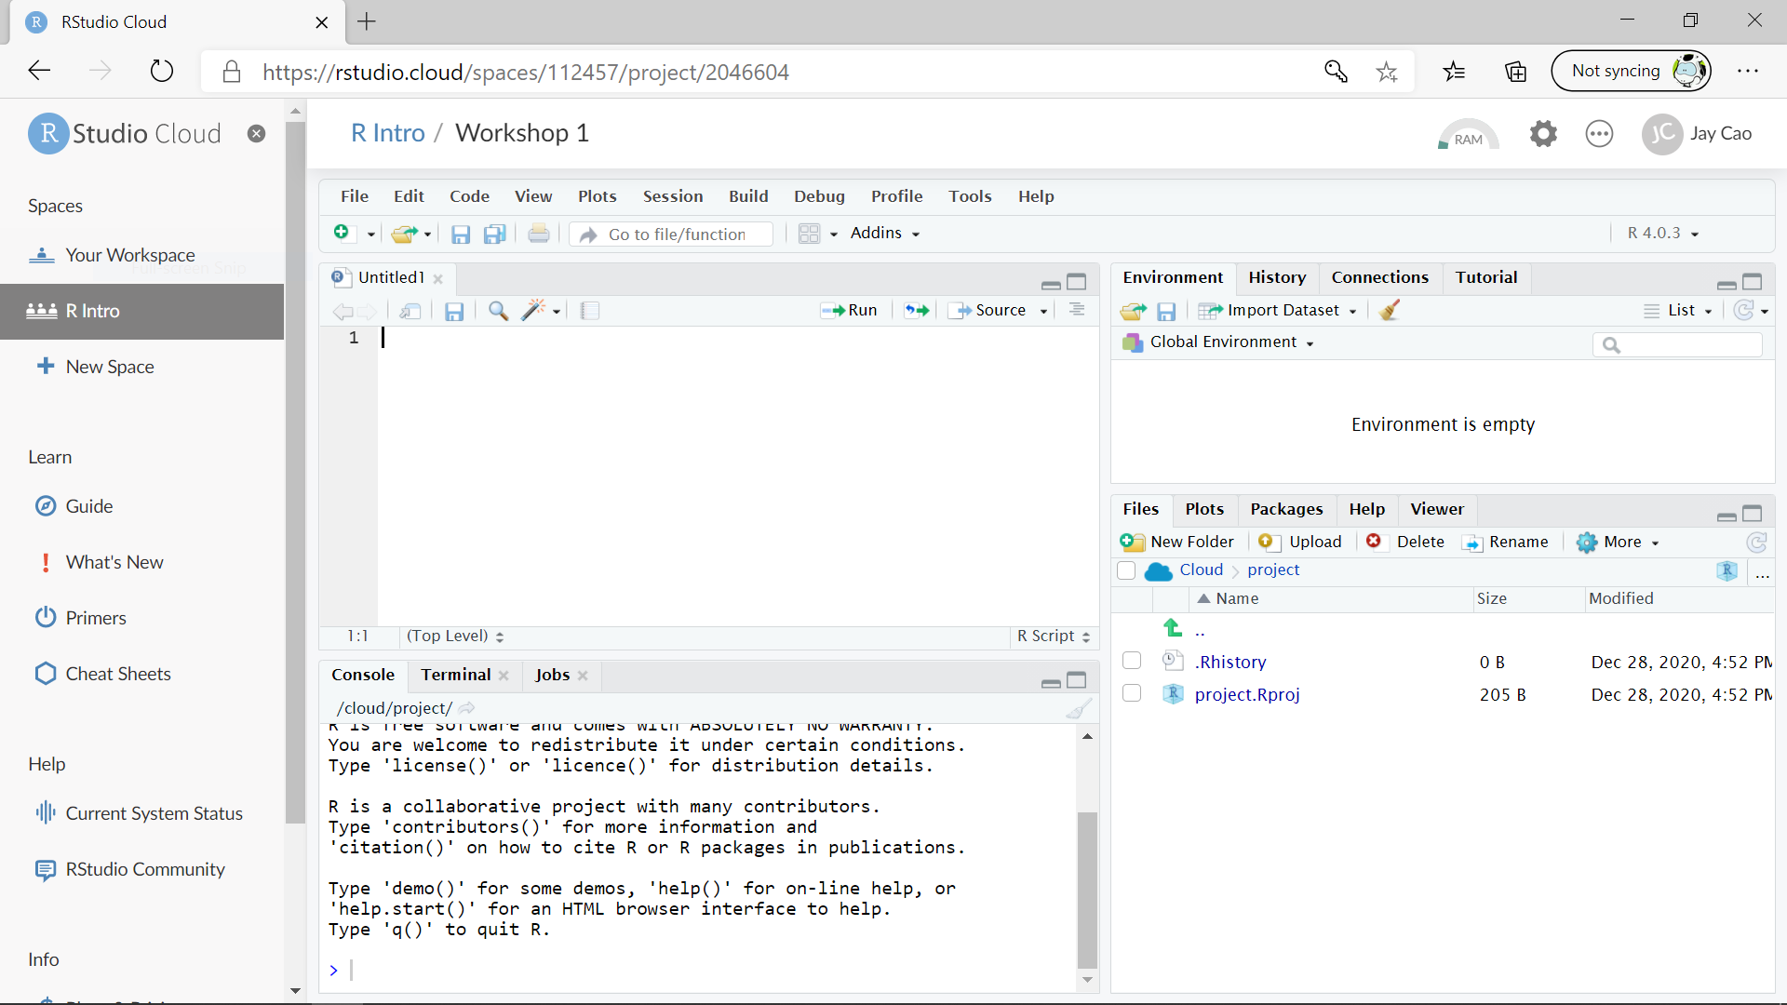
RStudio Cloud

Slide 16

RStudio at UofT Jupyterhub

Slide 17

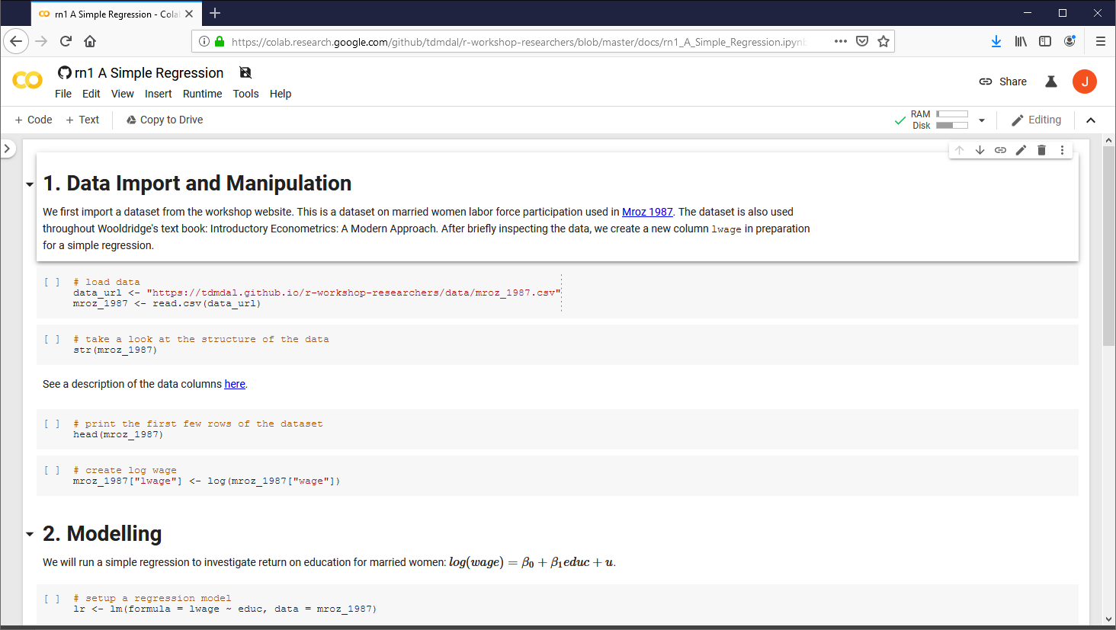
R Notebook in Google Colab

Slide 18
R Notebook at UofT Jupyterhub

Slide 19
Plan for Today
Intro to Intro
What is R and what can R do?
Setup R
Motivation examples
How to learn R and a quick walk-through
Basics of R programming
Data science with R
Learning Road Map and Resources

Slide 20


A Few Examples
PerformanceAnalytics
Package
Analyze portfolio performance
Look for trends in R community through Twitter
Recognize handwritten digits - an example of deep learning

Slide 21
A Few Examples: What to Look For
Focus on analysis workflow (by reading the code comments)
Import and manipulate data
Model data
Report and visualize results
Don’t focus on R syntax
Do notice everything is done in a sequential way
no conditional branching or looping

Slide 22
Plan for Today
Intro to Intro
How to learn R and a quick walk-through
Basics of R programming
Data science with R
Learning Road Map and Resources

Slide 23
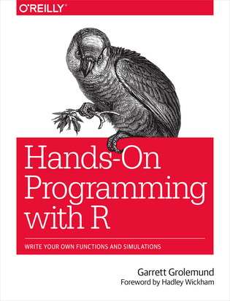

How to Learn R
Step 1. Basics of R programming
Data and programing structures (learn R syntax; relatively easy)
How to turn ideas into code (hard; takes time and practice)
Step 2. Data Science with R
Data wrangling
Modeling
Reporting and visualization
A Good Learning Approach
Learn underlying principles (e.g., why organize data in a certain way)
Learn best practices (e.g., follow a consistent analysis workflow)
Free books: Hands-On Programming with R; R for Data Science

Slide 24
Plan for Today
Intro to Intro
How to learn R and a quick walk-through
Basics of R programming
Expression & Assignment
Data Structure
Programming Structure (control flow & function)
Turn ideas into code
Data science with R
Learning Road Map and Resources

Slide 25
Expression and Assignment
# expression
2 + sqrt(4) + log(exp(2)) + 2^2
# assignment
x <- 3
y <- (pi == 3.14)

Slide 26
R Data Structure - Overview
 | Homogeneous | Heterogeneous
1-d | Atomic vector | List
2-d | Matrix | Data frame
n-d | Array
http://adv-r.had.co.nz/Data-structures.html

Slide 27
R Data Structure - Overview
 | Homogeneous | Heterogeneous
1-d | Atomic vector | List
2-d | Matrix | Data frame
n-d | Array
http://adv-r.had.co.nz/Data-structures.html

Slide 28
Atomic Vectors
# create R vectors
vec_character <- c("Hello,", "World!")
vec_integer <- c(1L, 2L, 3L)
vec_double <- c(1.1, 2.2, 3.3)
vec_logical <- c(TRUE, TRUE, FALSE)
Hello, | World!
1 | 2 | 3
1.1 | 2.2 | 3.3
TRUE | TRUE | FALSE

Slide 29
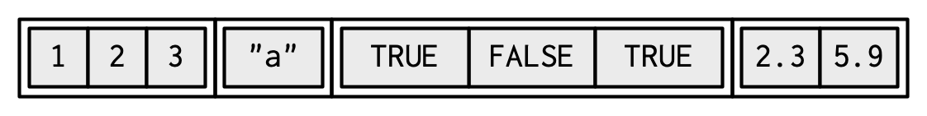
List
# create an R list
l1 <- list(
1:3,
"a",
c(TRUE, FALSE, TRUE),
c(2.3, 5.9)
)
ref. https://adv-r.hadley.nz/vectors-chap.html#list-creating

Slide 30
Data Frame
# create a data frame
df1 <- data.frame(
x = 1:3,
y = letters[1:3],
z = c(1.1, 2.2, 3.3)
)
x | y | z
1 | "a" | 1.1
2 | "b" | 2.2
3 | "c" | 3.3

Slide 31
Data Frame
# create a data frame
df1 <- data.frame(
x = 1:3,
y = letters[1:3],
z = c(1.1, 2.2, 3.3)
)
x | y | z
1 | "a" | 1.1
2 | "b" | 2.2
3 | "c" | 3.3

Slide 32
Data Frame
# create a data frame
df1 <- data.frame(
x = 1:3,
y = letters[1:3],
z = c(1.1, 2.2, 3.3)
)
x | y | z
1 | "a" | 1.1
2 | "b" | 2.2
3 | "c" | 3.3

Slide 33
A Cousin to Data Frame - Tibble
# load tibble library (part of tidyverse lib)
library(tibble)
# create a tibble
tb1 <- tibble(
x = 1:3,
y = letters[1:3],
z = c(1.1, 2.2, 3.3)
)
x | y | z
1 | "a" | 1.1
2 | "b" | 2.2
3 | "c" | 3.3
https://r4ds.had.co.nz/tibbles.html#tibbles-vs.data.frame

Slide 34
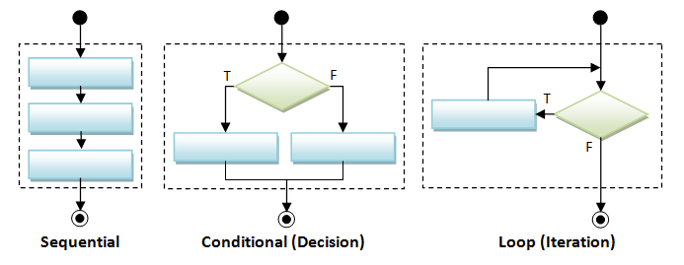
Programming Structure: Control Flows
Today
Learn yourself later (See Appendix)

Slide 35
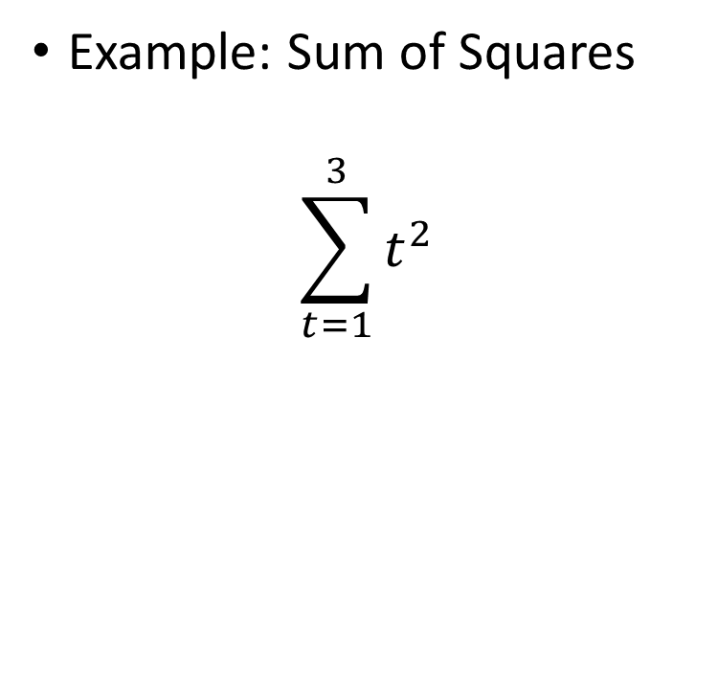
Sequential
Example: Sum of Squares
$$\sum_{t=1}^{3}{t^{2}}$$
# sum of squares
t <- 1:3
y <- sum(t^2)
print(y)

Slide 36
Sequential
Example: Sum of Squares
$$\sum_{t=1}^{3}{t^{2}}$$
# sum of squares
t <- 1:3
y <- sum(t^2)
print(y)
t
1 | 2 | 3

Slide 37
Sequential
Example: Sum of Squares
$$\sum_{t=1}^{3}{t^{2}}$$
# sum of squares
t <- 1:3
y <- sum(t^2)
print(y)
t
1 | 2 | 3
t^2
1 | 4 | 9
sum(t^2)
14

Slide 38
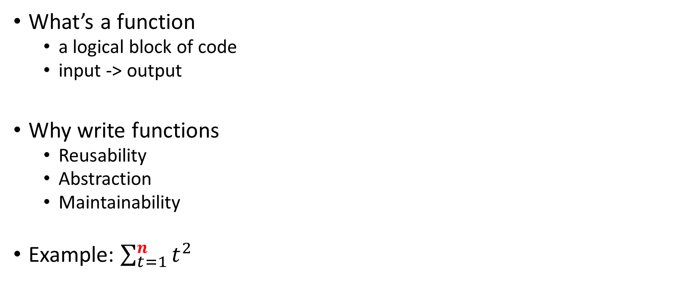
Programming Structure: Functions
# sum of squares from 1 to n
ss <- function(n) {
t <- 1:n
sum(t^2)
}
# calling the ss() function
print(ss(2))
print(ss(3))
What’s a function
a logical block of code
input -> output
Why write functions
Reusability
Abstraction
Maintainability
Example: $\sum_{t=1}^{n}{t^{2}}$

Slide 39
Programming Structure: Functions
# sum of squares from 1 to n
ss <- function(n) {
t <- 1:n
sum(t^2)
}
# calling the ss() function
print(ss(2))
print(ss(3))
What’s a function
a logical block of code
input -> output
Why write functions
Reusability
Abstraction
Maintainability
Example: $\sum_{t=1}^{n}{t^{2}}$

Slide 40
Programming Structure: Functions
# sum of squares from 1 to n
ss <- function(n) {
t <- 1:n
sum(t^2) # return(sum(t^2))
}
# calling the ss() function
print(ss(2))
print(ss(3))
What’s a function
a logical block of code
input -> output
Why write functions
Reusability
Abstraction
Maintainability
Example: $\sum_{t=1}^{n}{t^{2}}$

Slide 41
Turn Ideas into Code
Solve problems using code: three main ingredients
Data & Programming Structure + Algorithm (sorting, searching, optimization, etc.)
Examples
Sort a list of integers
Generate and solve Sudoku puzzles
Implement and backtest a trading rule/algorithm
For us, in most cases, we solve problems by
using other people’s algorithm implementations (functions from R packages)
Combine algorithms (and data & programming structures) to achieve our goal (still not easy; need practices to write good code.)

Slide 42
Plan for Today
Intro to Intro
How to learn R and a quick walk-through
Basics of R programming
Data science with R
A Typical data analysis workflow
Choice of R packages
An example: regression analysis
Learning Road Map and Resources

Slide 43

Data Science/Analysis Workflow
Use this workflow to organize your thoughts and code
https://r4ds.had.co.nz/introduction.html

Slide 44
An Example: Housing Price & Clean Air
Obs: 506
1. price median housing price, $
2. crime crimes committed per capita
3. nox nitrous oxide, parts per 100 mill.
4. rooms avg number of rooms per house
5. dist weighted dist. to 5 employ centers
6. radial accessibiliy index to radial hghwys
7. proptax property tax per $1000
8. stratio average student-teacher ratio
9. lowstat % of people 'lower status'
Manipulate data
Load data
Create new columns
Filter columns and rows
Build models
Multiple linear regressions
Report and graph
Build a publication-ready table for regression results

Slide 45
R Packages: Many choices, which one to use
Often, a task can be achieved using functions in different libraries
R is open and extensible!
Example: load a csv file to a data frame
Use read.csv() function from the utils library in Base R
Use read_csv() function from the readr library
Use fread() function from the data.table library
Use vroom() from the vroom library

Slide 46
R Packages: Many choices, which one to use
Start with the one most people use
Choose one that is well maintained
check document, github, etc. for last update date
packages maintained by companies (e.g., RStudio Co.) or academic teams
Choose one that suits your task

Slide 47
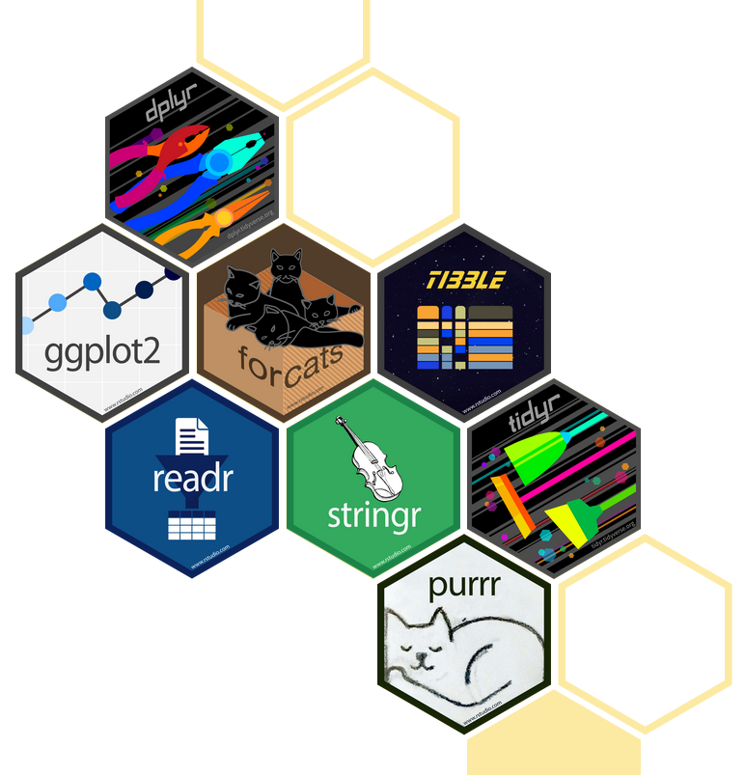
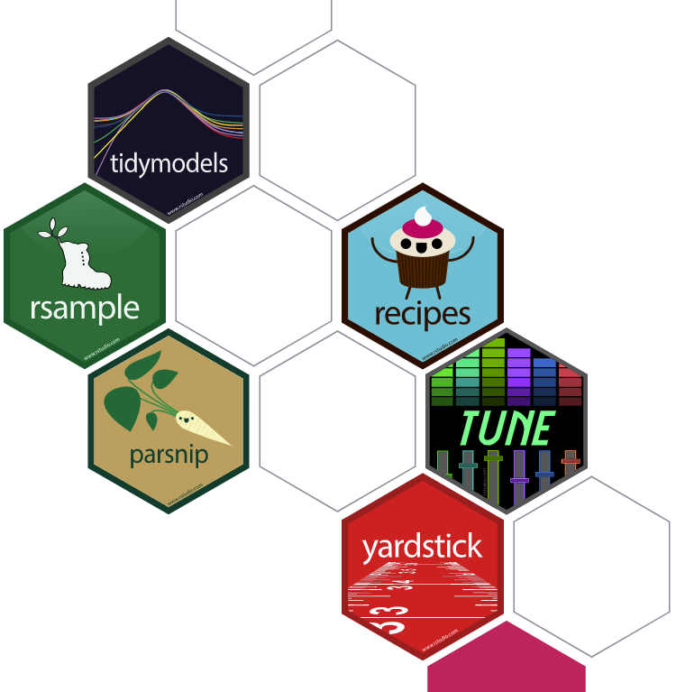
Great Choice for Data Science Work
Tidyverse
“an opinionated collection of R packages designed for data science”
“All packages share an underlying design philosophy, grammar, and data structures.”
Handle data manipulation, visualization, and much more
an eco-system: many package developers started to follow tidyverse principles too
Tidymodels
“a collection of packages for modeling and machine learning using tidyverse principles”
Manage modeling process but does not do modeling itself

Slide 48
Our Choice: the Regression Example
Manipulate data (tidyverse eco-system)
Load data (read_csv() from the readr)
Create new columns (mutate() from dplyr)
Filter columns and rows (select() and filter() from dplyr)
Build models
Multiple regression (lm() from stats library in R base)
Report and graph
Build a publication-ready table (huxreg() from huxtable library)

Slide 49
Using R packages/libraries
Install an R library (only need to install a library once)
install.packages("library_name")
Load an R library (before you use a library)
library(library_name)
CRAN (The Comprehensive R Archive Network)
CRAN Task Views

Slide 50
Load a CSV file
read_csv() from the readr
read_csv(file)
e.g. hprice <- read_csv("hprice.csv")
More about read_csv()
More about readr

Slide 51
Data Manipulation: dplyr basics
Filter observations (rows): filter()
filter(my_dataframe, condition1, …)
e.g., hprice_reg <- filter(hprice, price > 20000)
Select variables (columns): select()
mutate(my_dataframe, new_var1 = expression1, …)
e.g., hprice_reg <- mutate(hprice_reg, lprice = log(price))
Create new variables: mutate()
select(my_dataframe, var1, …)
e.g., hprice_reg <- select(hprice_reg, lprice, rooms)

Slide 52
Data Manipulation: Data Pipe (%>%)
hprice_reg <- filter(hprice, price > 20000)
hprice_reg <- mutate(hprice_reg, lprice = log(price))
hprice_reg <- select(hprice_reg, lprice, rooms)
hprice_reg <- hprice %>%
filter(price > 20000) %>%
mutate(lprice = log(price)) %>%
select(lprice, rooms)

Slide 53
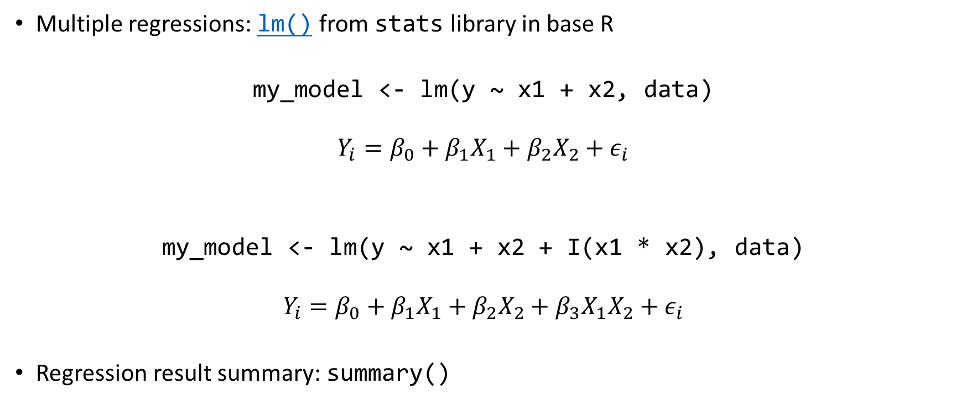
Regression
Multiple regressions: lm() from stats library in base R
my_model <- lm(y ~ x1 + x2, data)
$$Y_{i}=β_{0}+β_{1}X_{1}+β_{2}X_{2}+ε_{i}$$
my_model <- lm(y ~ x1 + x2 + I(x1 * x2), data)
$$Y_{i}=β_{0}+β_{1}X_{1}+β_{2}X_{2}+β_{3}X_{1}X_{2}+ε_{i}$$
Regression result summary: summary()
Ref. https://faculty.chicagobooth.edu/richard.hahn/teaching/FormulaNotation.pdf

Slide 54
Report
Summary table
Summary for lm(): summary(my_model)
publication-ready table: huxreg() from huxtable library
huxtable(my_model1, my_model2, …)
Ref. https://hughjonesd.github.io/huxtable/huxreg.html

Slide 55
Plan for Today
Intro to Intro
How to learn R and a quick walk-through
Basics of R programming
Data science with R
Learning Road Map and Resources

Slide 56
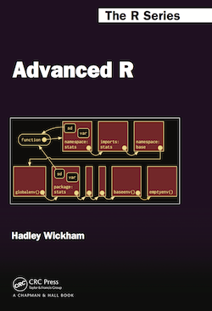
Learning Road Map (Three Free Books)
Step 1. Basic R programming skills (Never programmed before? Start here.)
Data and programming structure; how to turn an idea into code;
Book: Hands-On Programming with R
Step 2. R Data Science skills
Data wrangling, modeling, and visualization/reporting; Best practice;
Book: R for Data Science
Step 3. Take your R Skill to the next level
Book: Advanced R
Other free books check bookdown.org often

Slide 57
Free Learning Resource
RStudio Education
Choose Your Learning Paths
RStudio Video Resources Site
More free R books? Check bookdown.org often
Coursera: Search R and learn
free for UofT students (mostly always free if you just audit the courses)
Twitter (a few seeds: #rstat, @hadleywickham, @WeAreRLadies)

Slide 58
Appendix
Programming Structure Continued
Conditional
Iteration

Slide 59
Conditional (if…else…)
if (cond) {
# run here if cond is TRUE
} else {
# run here if cond is FALSE
}
# y greater than 10?
if (y > 10) {
print("greater than 10")
} else {
print("less or equal to 10")
}

Slide 60
Conditional (if…else…)
if (cond) {
# run here if cond is TRUE
} else {
# run here if cond is FALSE
}
# y greater than 10?
if (y > 10) {
print("greater than 10")
} else {
print("less or equal to 10")
}
T
y>10?
F
“great…”
“less…”

Slide 61
Conditional (if…else if…else…)
if (cond1) {
# run here if cond1 is TRUE
} else if (cond2) {
# run here if cond1 is FALSE but cond2 is TRUE
} else {
# run here if neither cond1 nor cond2 is TRUE
}

Slide 62
Iteration
for (var in seq) {
do something
}
while (cond) {
do something if cond is TRUE
}
# sum of squares
t <- 1:3
y <- 0
for (x in t) {
y <- y + x^2
}
print(y)

